Slide 1
“Data” joBs in the US Market
Han Yang, Will Copeland, Shilpa Muralidhar

Slide 2
Shilpa
Why are we presenting on ”data jobs”?

Slide 3
Questions
Each question corresponds to a graph(s). Fill this slide in once all graphs are added

Slide 4
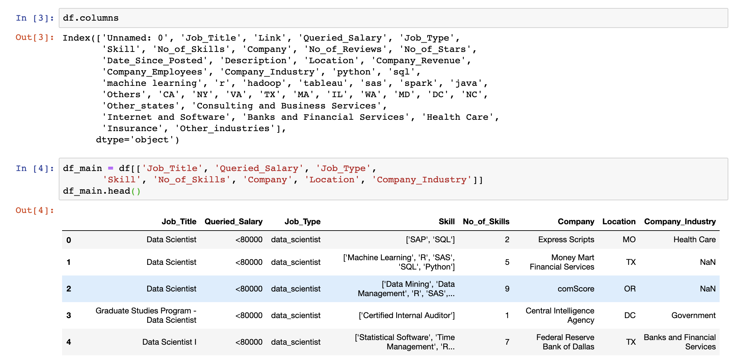
Flowchart
Process of data cleaning
Got it from Kaggle
It’s 9-months old
What does it look like? Columns etc?
Pre-cleaning

Slide 5
Shilpa – 2-3 slides here
What is the distribution of data jobs by state?

Slide 6
Han – 2-3 Slides
What is the distribution of skills?

Slide 7
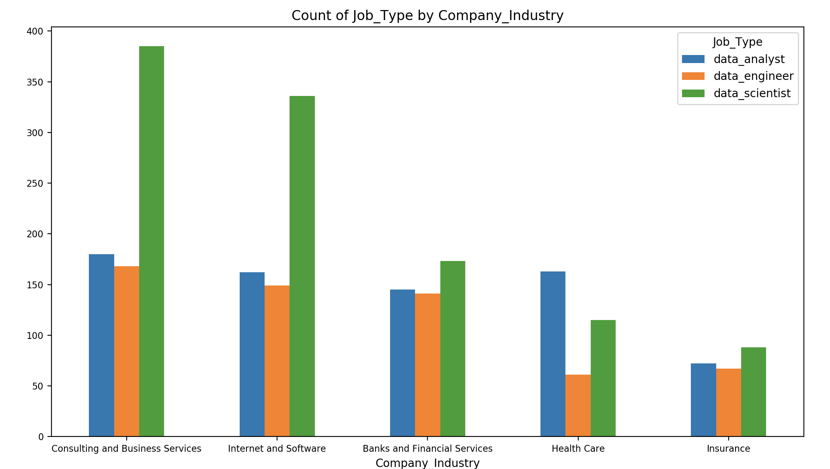
Jobs Counts in the top Industries
What is the distribution of “data jobs” in different industries?
Graph of total job counts in each industry

Slide 8
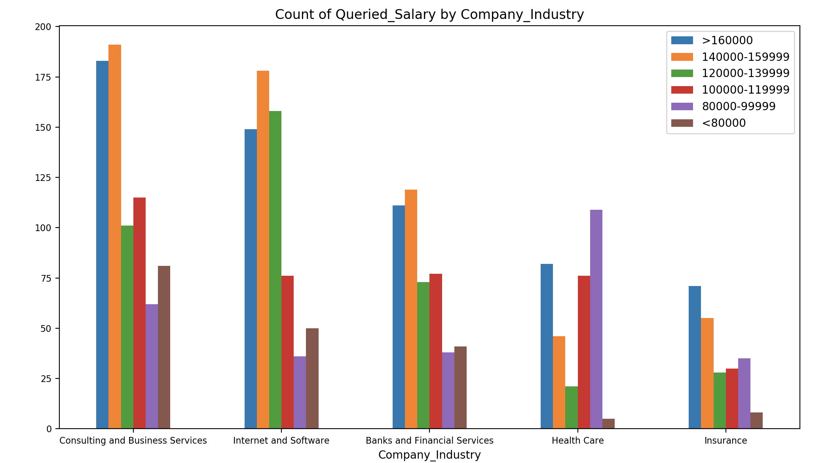
Salaries in the top Industries
What is the distribution of “data jobs” in different industries?
Graph of total job counts in each industry

Slide 9
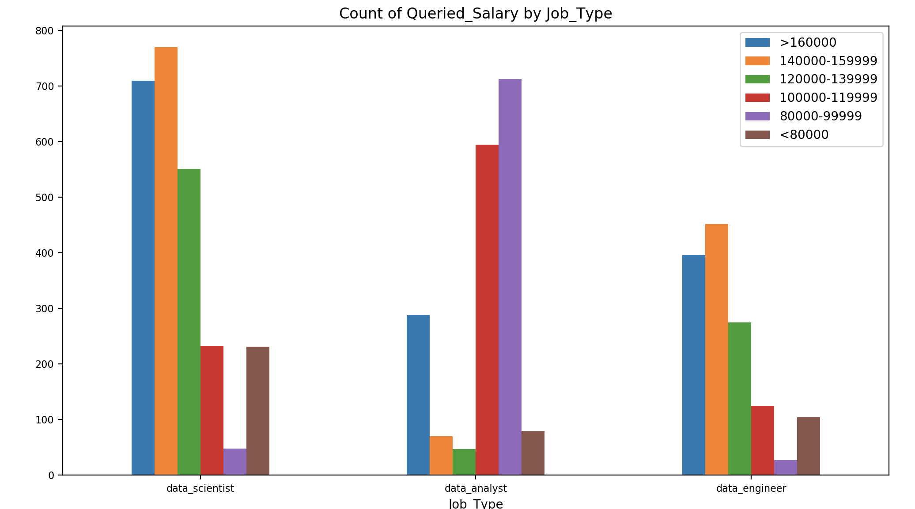
Salaries by Job Type in the Top Industries
What is the distribution of “data jobs” in different industries?
Graph of total job counts in each industry

Slide 10
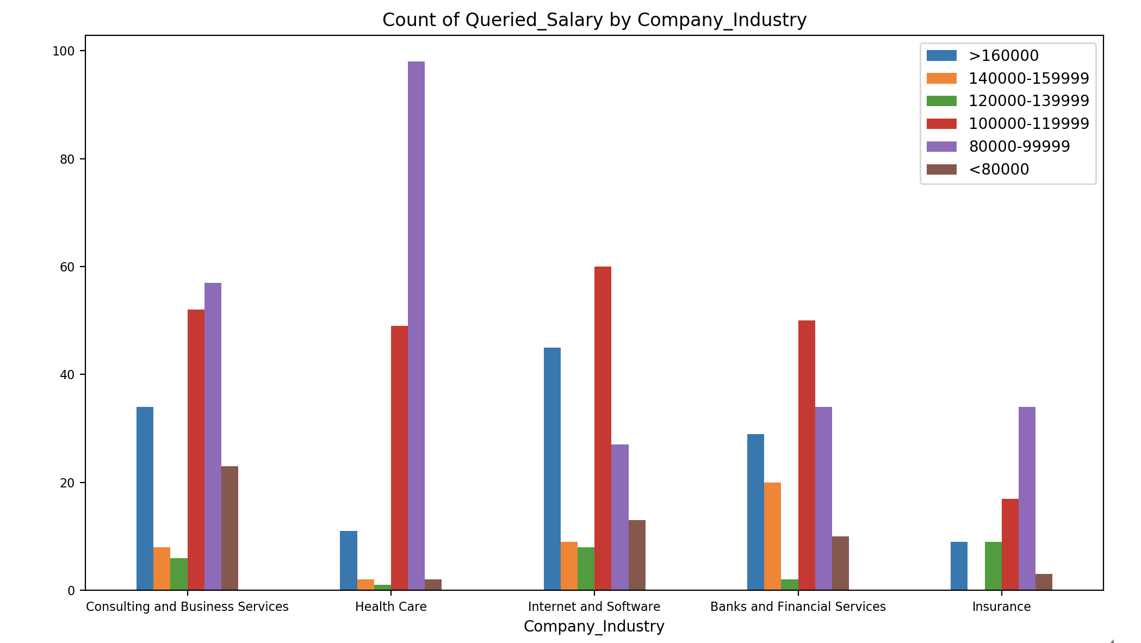
Data Analyst Salaries in the Top Industries
What is the distribution of “data jobs” in different industries?
Graph of total job counts in each industry

Slide 11
Major conclusions – we each reiterate from our slides
States
Skills
Industries

Slide 12
The End
Questions?

